Slide 1
Libraries and Open Science:
The Utrecht Example
ADBU Workshop
Paris, 21 November 2017
Anja Smit
University Librarian
Notes:
Academic Libraries have always played a crucial role in scholarly communication. By preserving text, libraries provide access to knowledge, so that new knowledge can be created by researchers. Libraries have always done this across the globe and across generations. By functioning as gateways to knowledge, libraries have gathered experience and expertise on what it takes to share knowledge, especially in published books and scholarly journals.

Slide 2
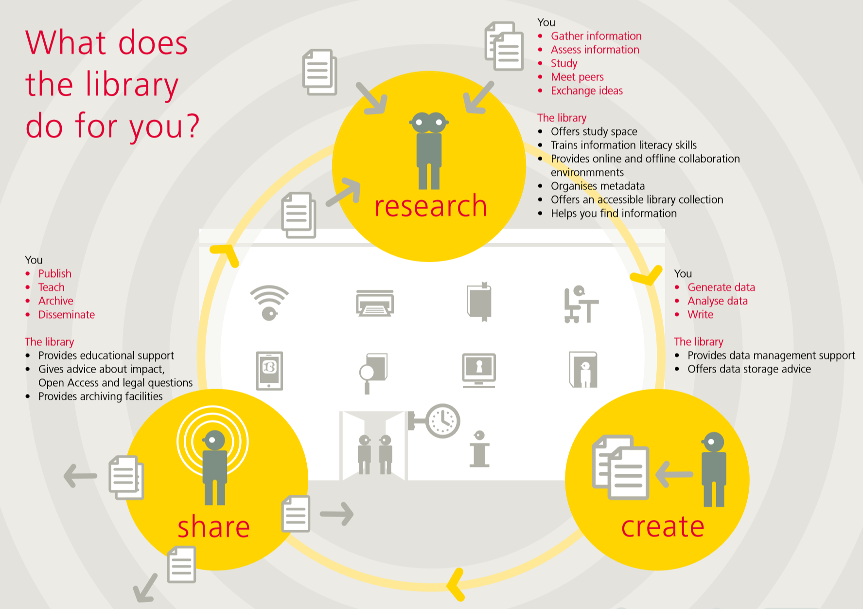
Notes:
Today the internet is the gateway to information. It creates great opportunities and distruptive changes in research worklfows: research results can take on a variety of formats and can be shared in all stages in the research workflow, not just as a formal publications.
For new formats such as research data, new environments are needed to preserve and share them: solid infrastructures, international standards, structured metadata to support retrieval, taxonomies, metadata-management and so on. These are exactly the areas of expertise of libraries.
In addition, open and transparent research is a natural mission for libraries, relating strongly to our core task of enhancing access to knowledge. Therefore, libraries have been the champions of open access from the start.
In short, libraries are well positioned play a significant role in supporting researchers in sharing their knowledge in all stages of their research workflows and.
I will demonstrate this by sharing with you in some detail the example of Utrecht University.

Slide 3
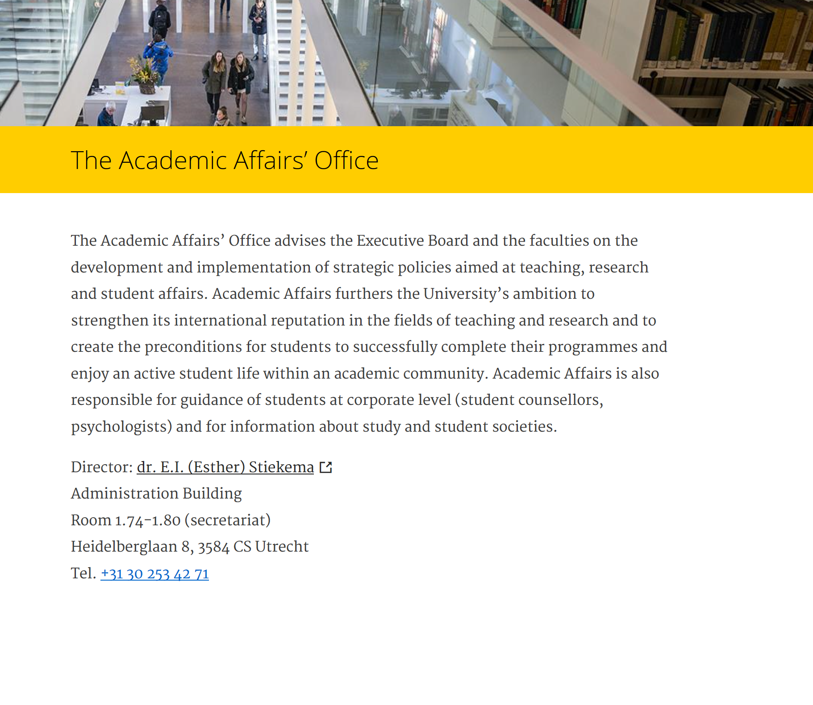
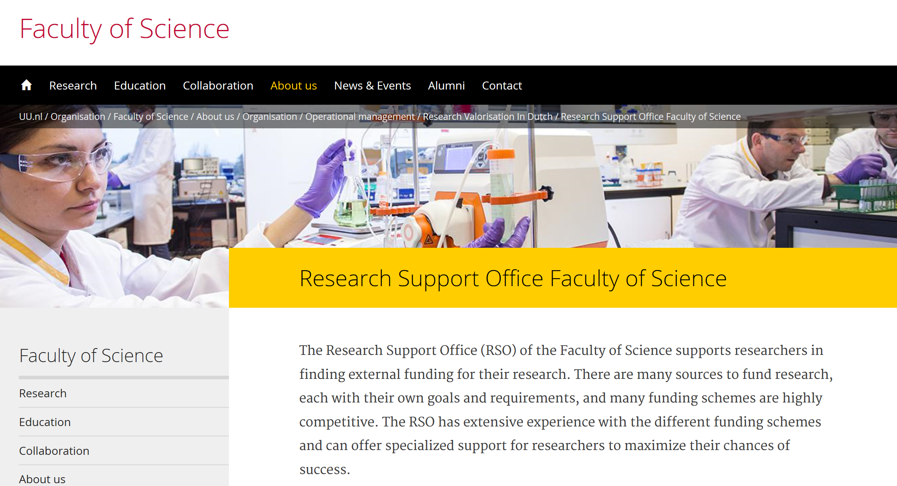
Notes:
In Utrecht University research support is organized with one central Office of Academic Affairs and severral decentral Research Support Offices in the faculties. The central office of Academic Affairs focusses on policies, the Decentral Research Support Offices focus on helping researchers find funding for their research projects.

Slide 4
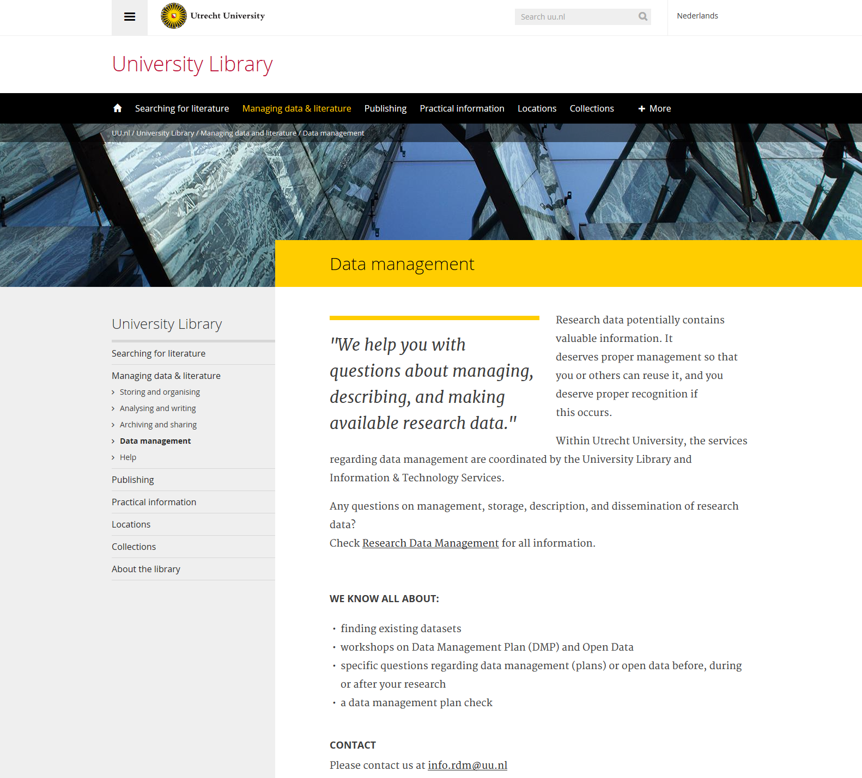
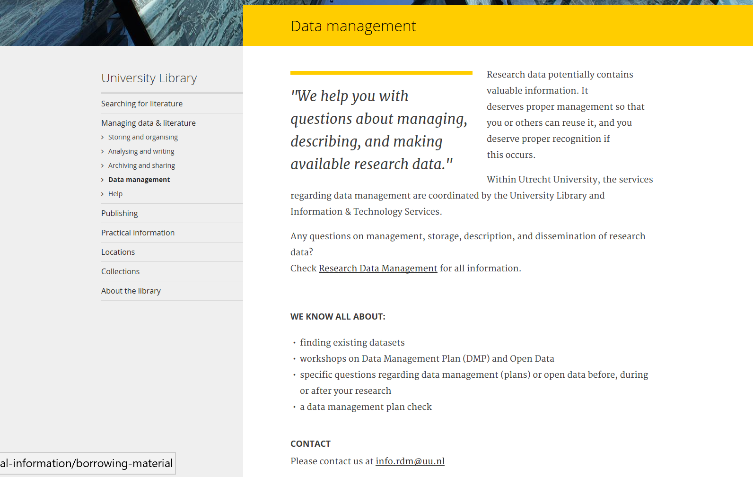
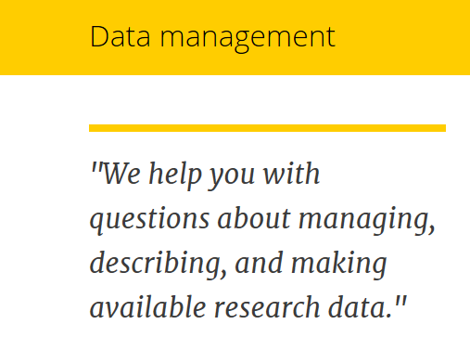
Notes:
The library is of course, also involved in research support. As an organization, the library is a separate service and reports directly to the Rector Magnificus, who is in charge of Research and Teaching strategy. The Rector looks at the library to advise him on open access strategy and implementation, and more in general sees the library as an excellerator for the innovation of scholarly communication, especially with regards to the open science agenda.

Slide 5
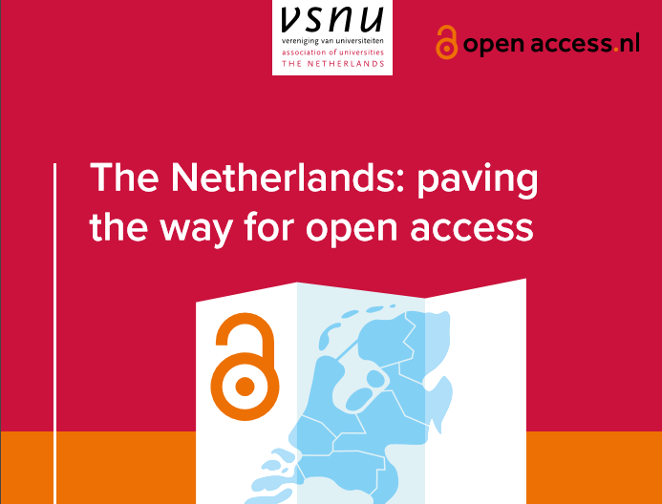
2014
Notes:
As we all know, the Open Science Landscape is complex, with players at international, national and local level. The Dutch Government has been active on the topic of open science since 2014, when the state Secretary for Education set a goal for open access to publications through the Golden Route: via the publishers’ legacy journals.

Slide 6

100% full open access to publications in 2020
Make research data optimally suited for reuse
Develop recognition and rewards systems
Promote and support open science
2017
Notes:
This year, the ministry of Education initiated a National Open Science Plan, which is re-enforced by our new kabinet.

Slide 7




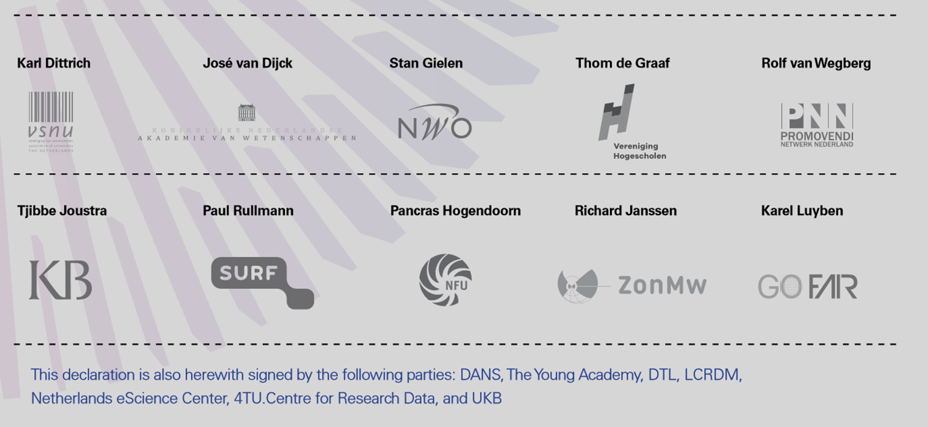
Notes:
It is a plan of our ministry, together with 9 other stakeholders: universities, research funders, the Royal Netherlands Academy of Arts and Sciences, the National Library, and so forth. The Dutch Association of Universities, the VSNU, is one of the stakeholders. Utrecht University aligns its own activities with this national plan, including the development of Research Data Management services.

Slide 8
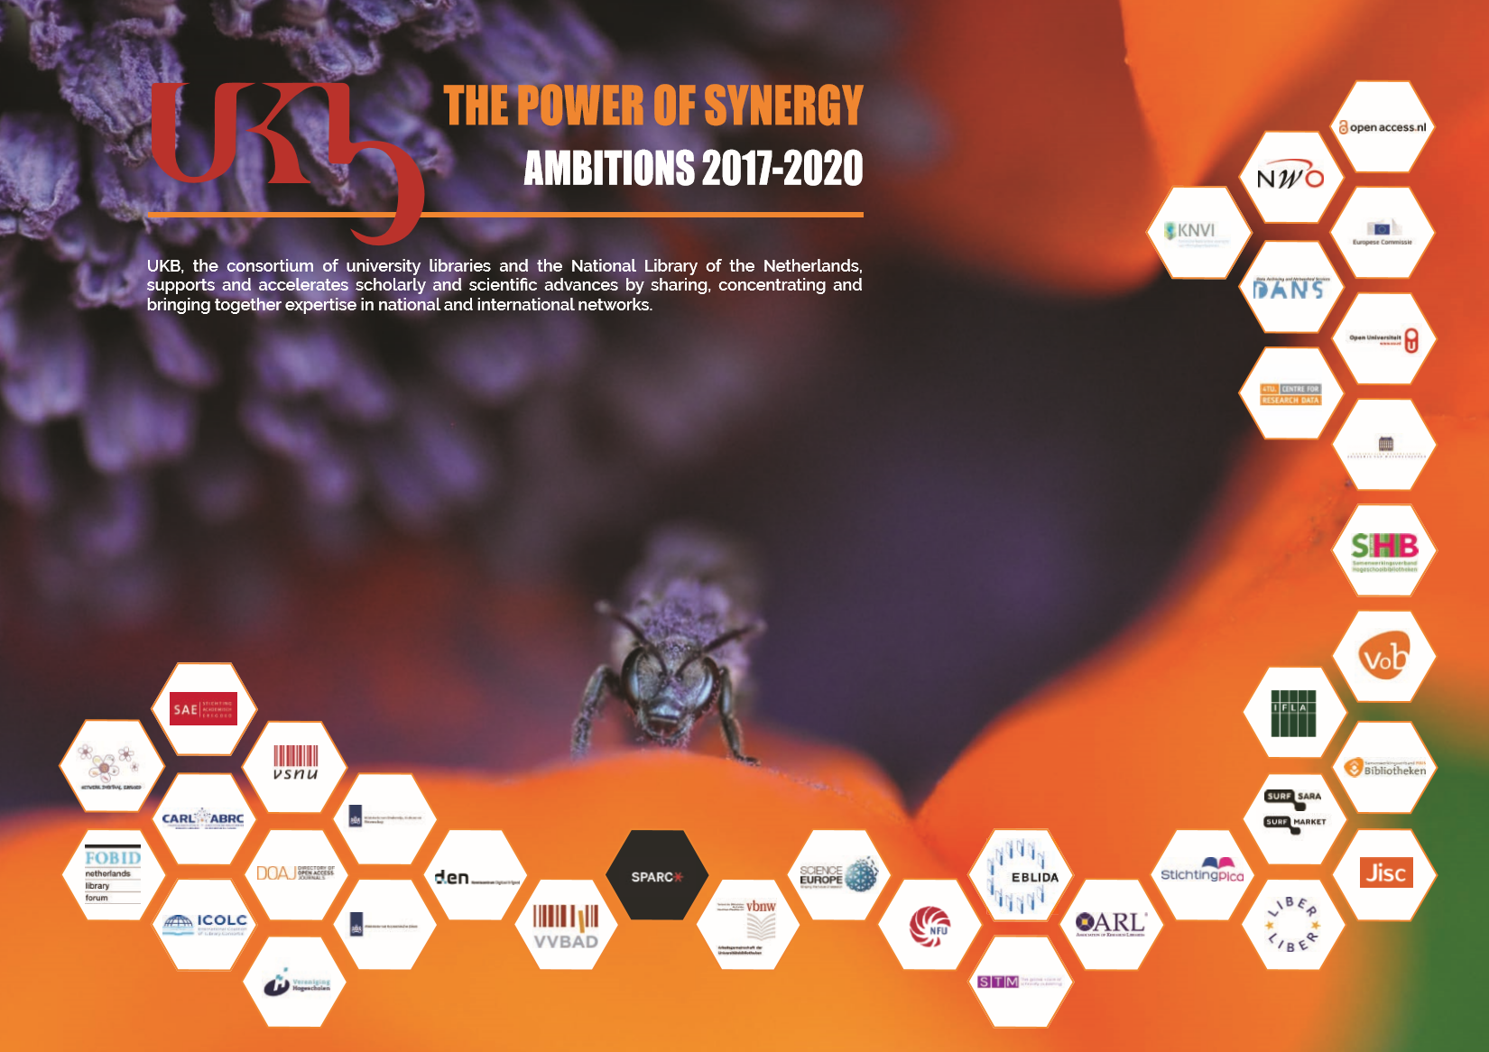
Notes:
UKB, the Dutch ADBU, works closely together with the VSNU in implementing the National Open Science Plan.

Slide 9
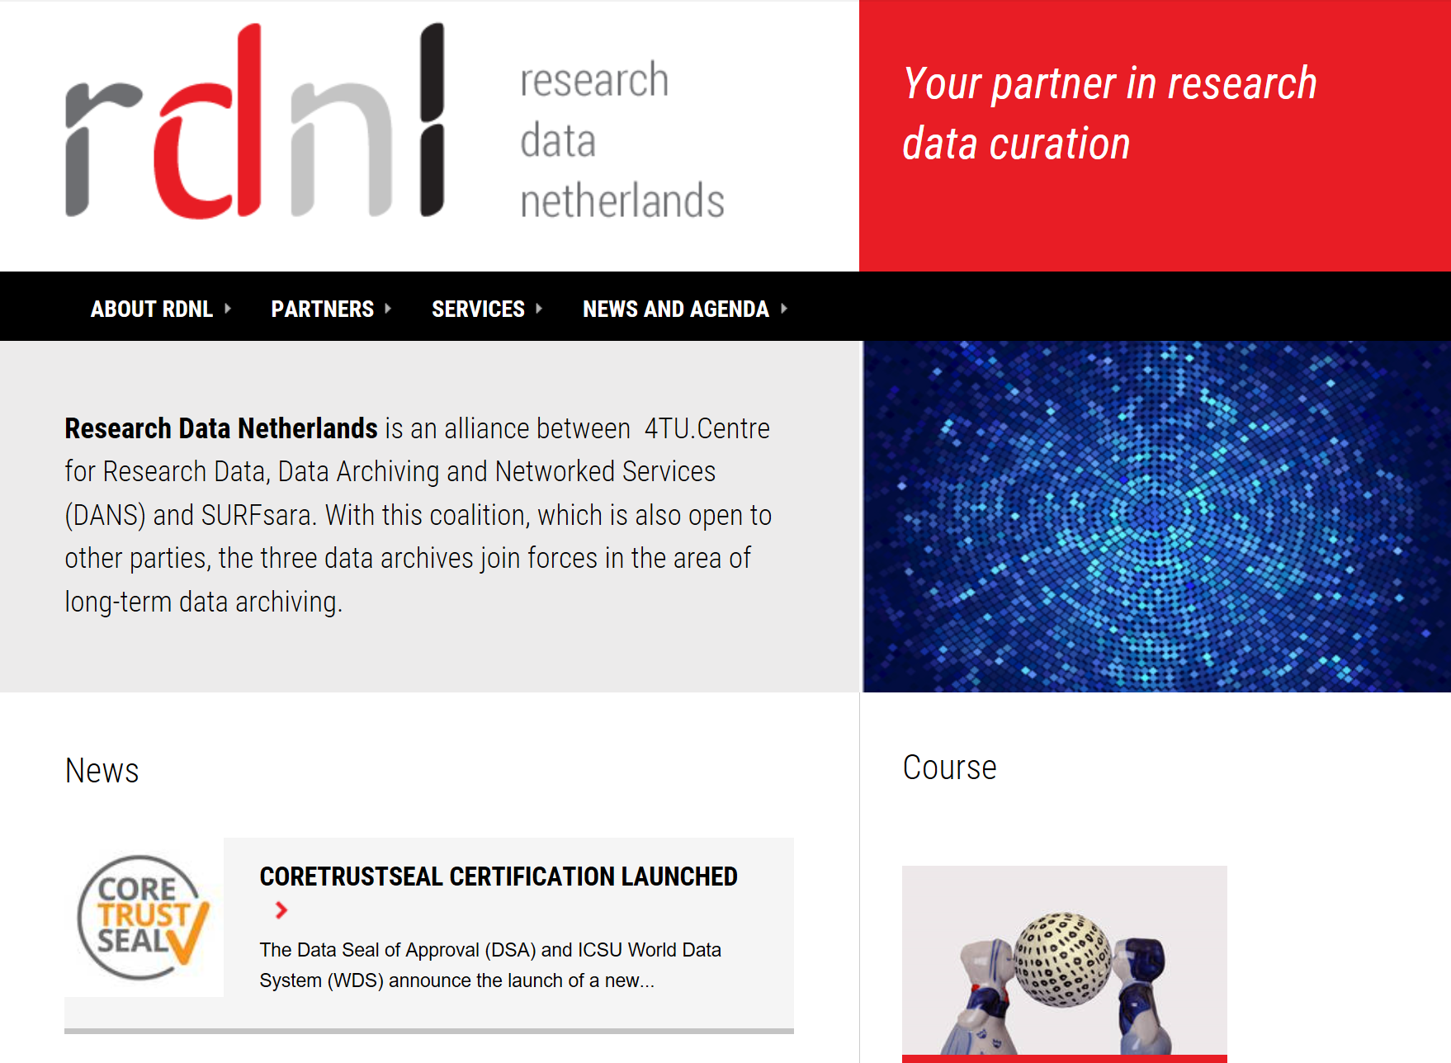

Notes:
With regards to research data management, there are several national initiatives, such as
- Research Data Netherlands, a national collaborative for research data curation and access, in which libraries are involved through one of the partners: DANS,

Slide 10

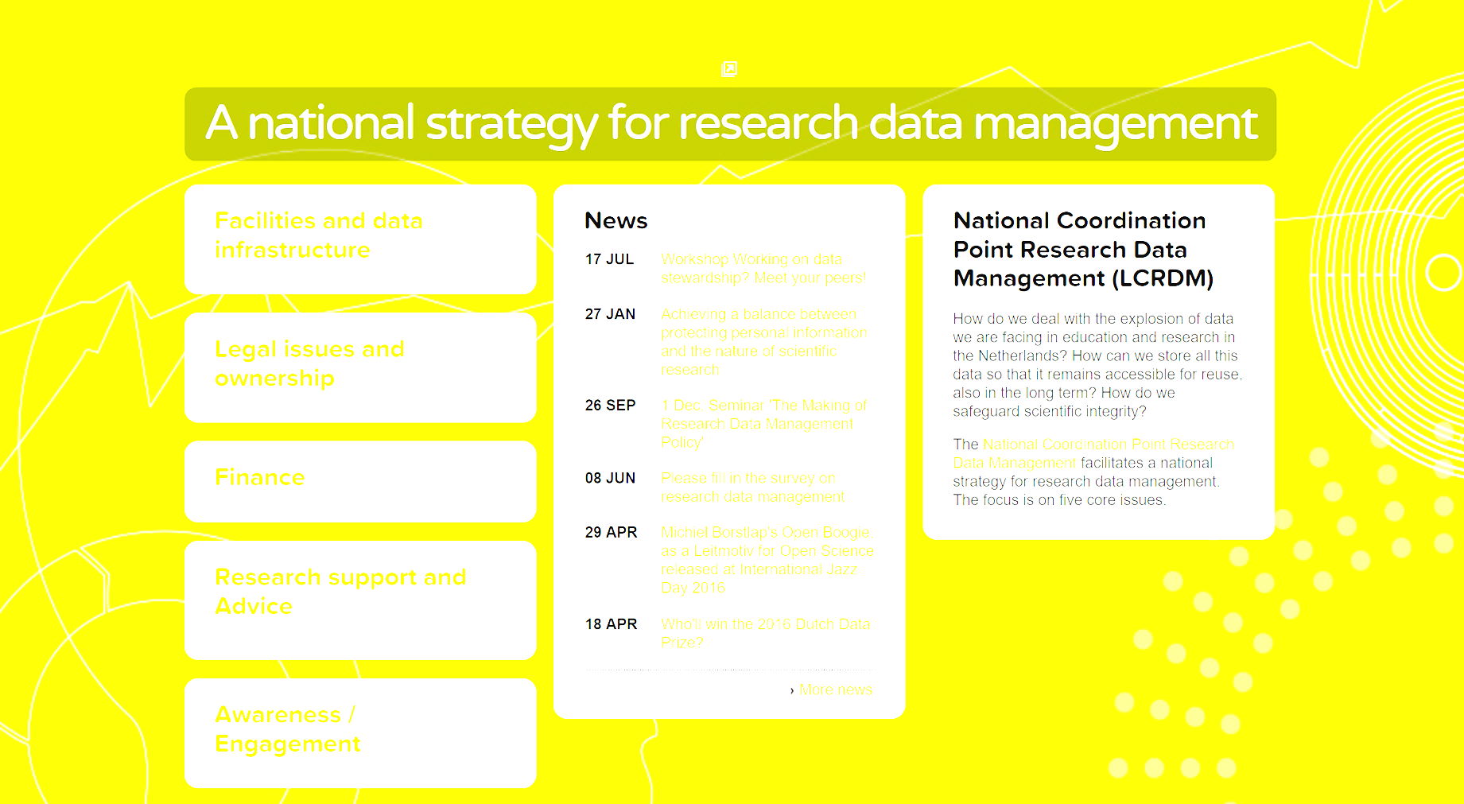
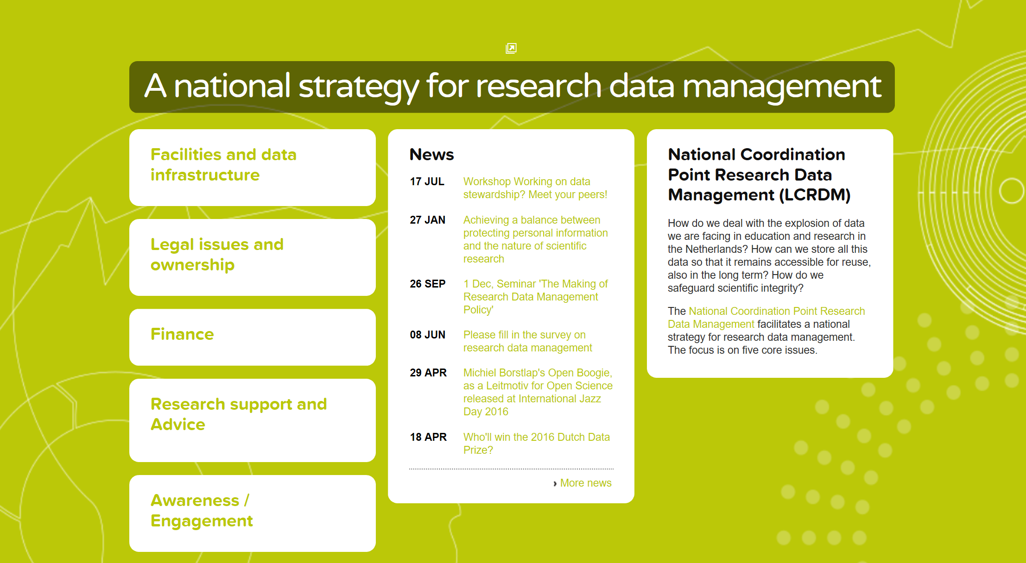
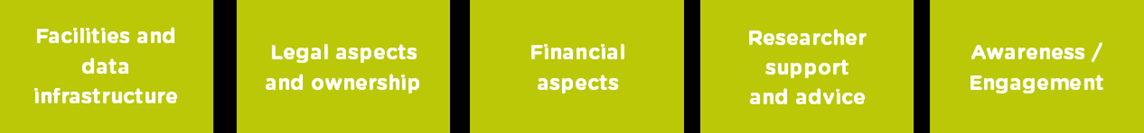
Notes:
And:
- The National Coordination Point Research Data Management, which covers many aspects of RDM:
Facilities and data infrastructure
Legal aspects and ownership
Financial aspects
Researcher support and advice
Awareness and engagement
University Libraries are part of all working groups of this body, except the one on financial aspects.

Slide 11
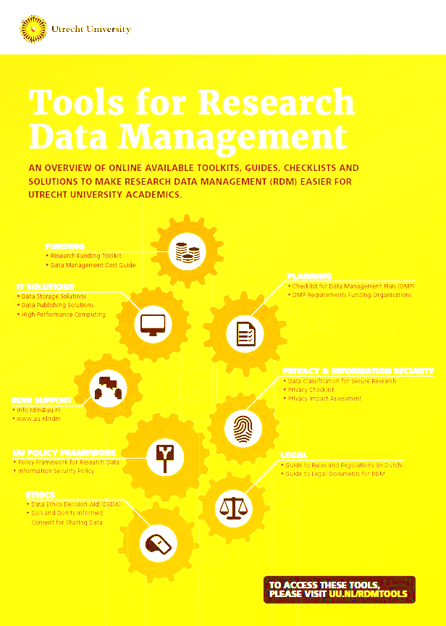
ResearchIT
Goals:
Develop infrastructure
Provide tooling to handle data
Develop Research Data Management Support
Notes:
In 2016, Utrecht University also started a project to implement research data curation services: ResearchIT. It includes developing a data infrastructure, tooling to handle data and RDM-support. This project is run by IT Services together with the library. IT focuses on the storage facilities. It offers a solution for large research projects for storage and repository functionality, possibly also a publication layer in the future.

Slide 12
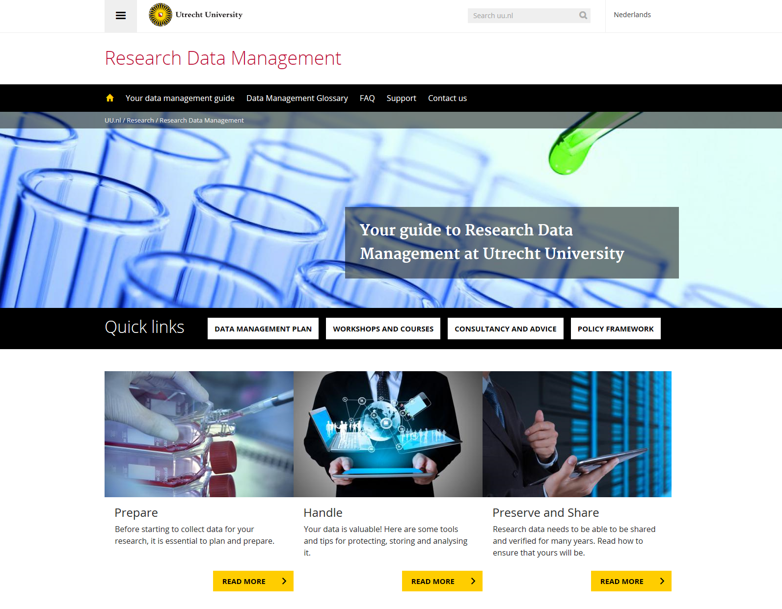
Wat is het?
ResearchIT
Infrastructure
Tooling
Support
The library leads the implementation of RDM-Support.
Notes:
The library leads the implementation of RDM-Support.

Slide 13
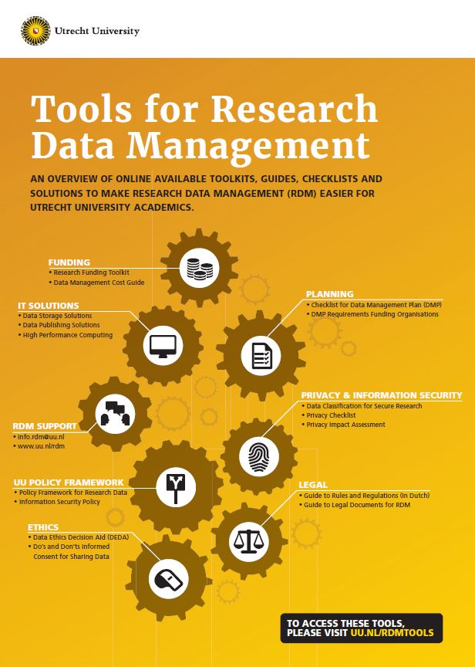
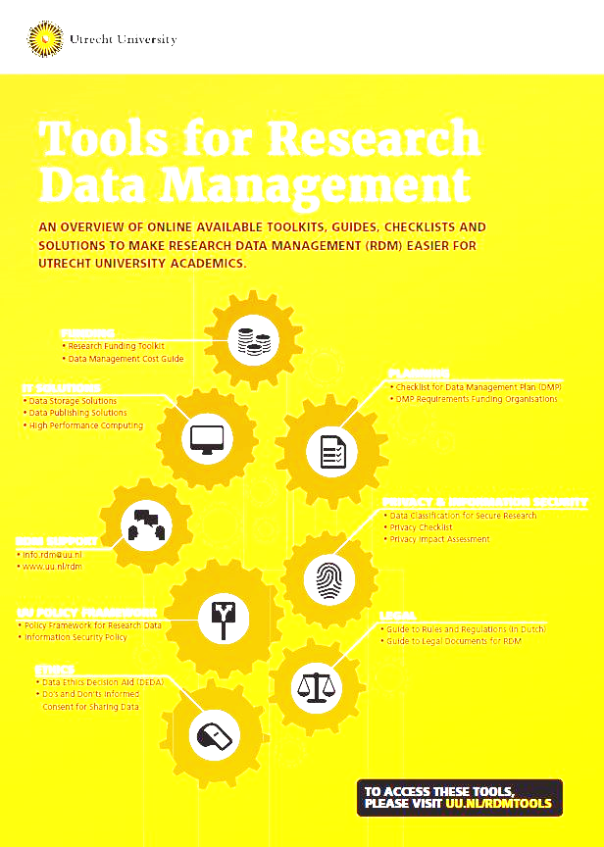
Notes:
And these are the ‘tools’ for handling data.
Within Utrecht University, a policy framework on for research data was adopted in 2016. The library was the imitator of this policy in 2015. The Policy Framework provides definitions, general guidelines, basic premises and principles, and delineates responsibilities with regards to research data. Faculties are responsible for implementation of this policy and in practice produce their own research data policies. The policy framework was not broadly discussed within the faculties or the research community before or after adoption. Maybe therefore, is not widely known within the research community.

Slide 14
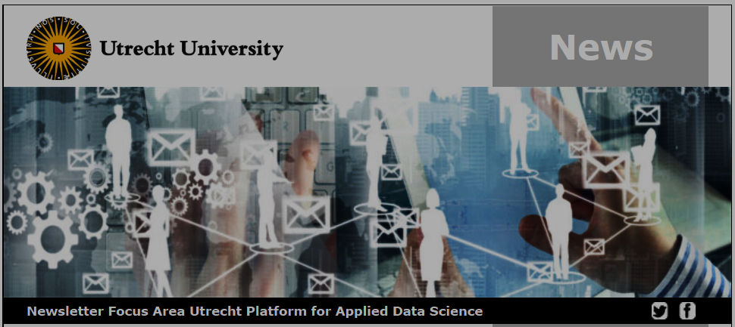
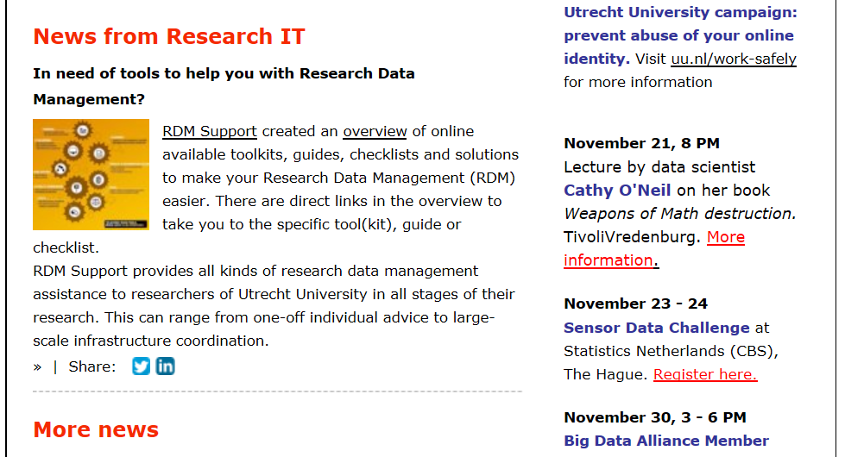
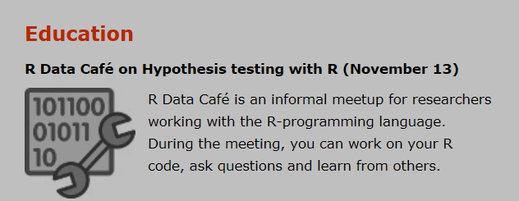

Slide 15
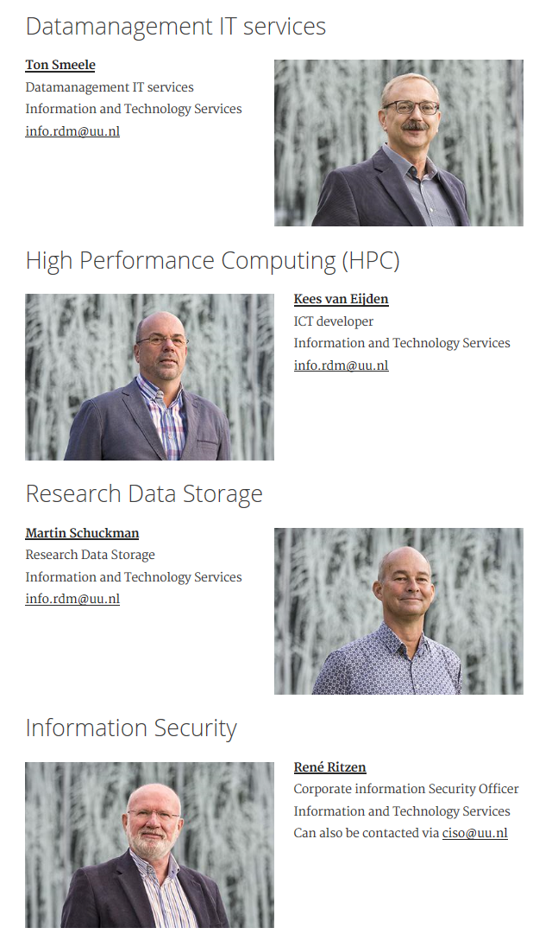
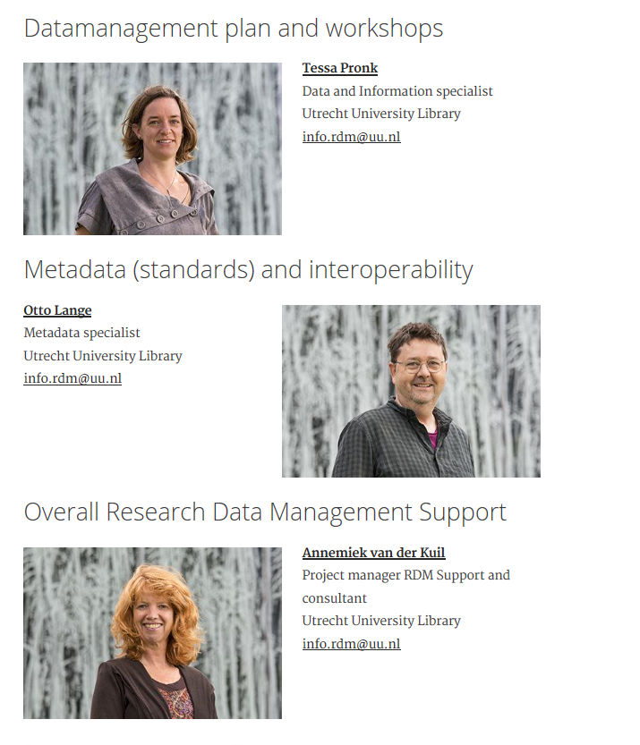
Notes:
In ResearchIT, the IT and Library staff are working as one team to support researchers handling research data across all disciplines. The team advices researchers on storage solutions, structuring metadata and how to write a data management plan.

Slide 16
online RDM training
DMPonline
RDM website
Prepare
Data collection
Data documentation
Handle
Data storage
Data security
Preserve and share
Data selection and preservation
Data availability for reuse
Prepare
Data collection
Data documentation
Handle
Data storage
Data security
Preserve and share
Data selection and preservation
Data availability for reuse
Prepare
Data collection
Data documentation
Handle
Data storage
Data security
Preserve and share
Data selection and preservation
Data availability for reuse
GUIDANCE
REVIEW
Machine actionable
Connect with Research Funding and Graduate Schools
UU PURE
FUNDER
NL coop
Integrate RDM, info security, privacy, ethics, research funding
Notes:
Every researcher is required to write a data management plan for his or her project. The RDM-team receives an increasing amount of inquiries and requests for help and reviewing draft plans. Last year, 18 workshops on how to write a data management plan were sold out.
This format is not scalable, so we are now designing online training containing 8 modules. It will be available in February 2018. We are also piloting the implementation of the tool DMPOnline in the Humanities Faculty. In June 2018, we hope to offer DMPOnline to all faculties. The tools provide guidance, which is supported by a website. This website currently provides a DMP checklist. The RDM-team will review DMP’s on request.

Slide 17

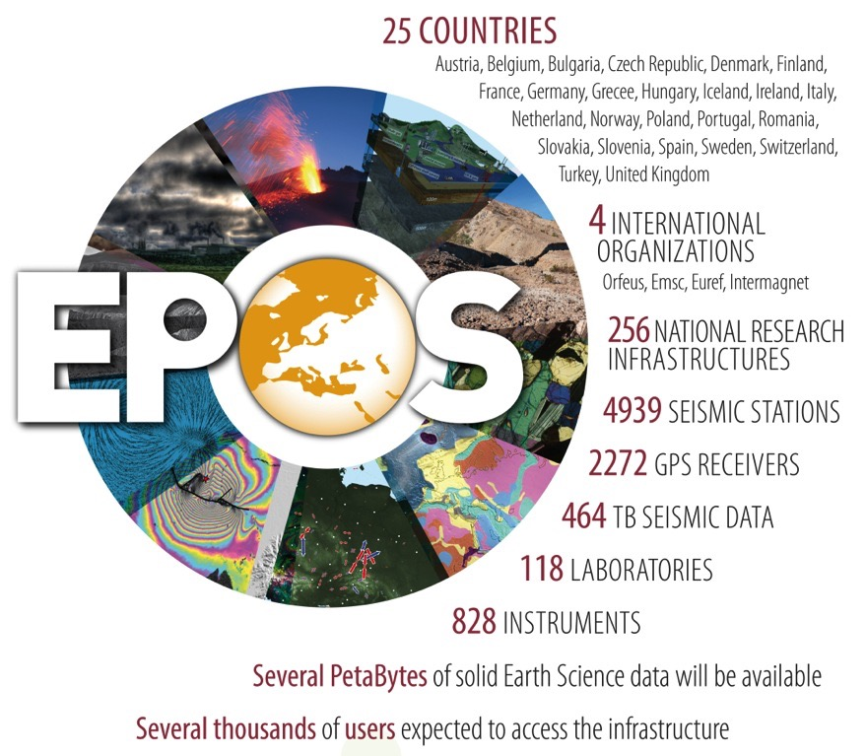
Notes:
Besides RDM services within the RDM team, library staff also work embedded in faculties or large research programmes. One example is a Metadata Specialist, who is a work package leader within the EU Geo Sciences Programme EPOS. Another is a Data Manager, working for a Social Sciences Research Programme, managing research data.

Slide 18
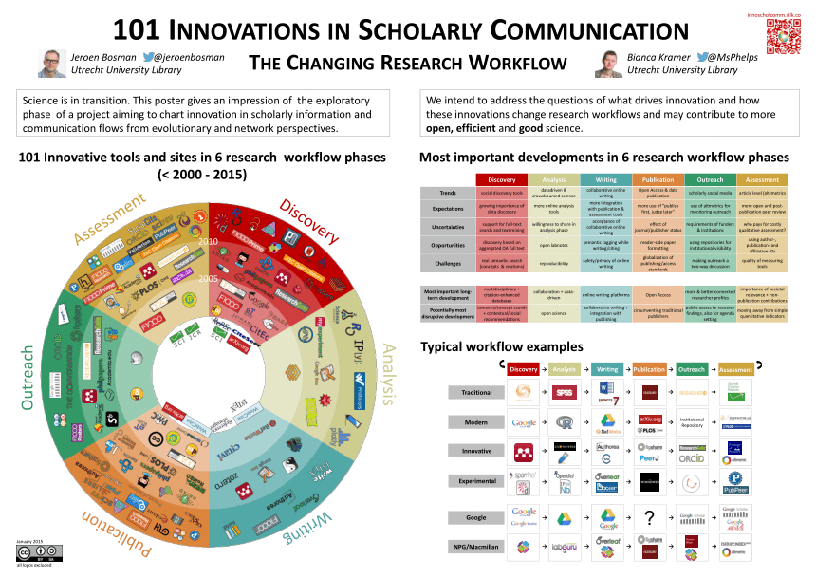
Notes:
We also do trend watching. This is a survey staff members put out worldwide, which drew 20.000 respondents.

Slide 19

Academic Services
Collection
Services
Open
Science
Library
as a Place
Notes:
The library currently has 11 fte working in Open Science Support, out of 33 fte in the reference department – called Academic Services. 3,3 fte is dedicated to RDM. We are gradually growing our fte for open science. We transform staff FTE by increasing efficiencies within Collection Services, for example in cataloguing and collection development. Open access support has been part of our operations for the last 14 years. The way we have organized these new tasks, has changed over time.

Slide 20


Open access
Expert group
RDM
Expert group
Intellectual property
Expert group
S u b j e c t
E x p e r t i s e
Outreach & Assessment
Expert group
Learning (incl OER)
Expert group
Collection/acquisition
Expert group
F a c u l t i e s
Notes:
This is our current organization. Because Utrecht University is a large, general university, we want to keep the structure of dedicated support teams for the faculties. This also makes sense for open science support, because disciplines differ in publishing culture, research method and data management.
We expect to grow our open science services. We need new staff with expertise in research workflows in one or more discipline, data management, text- and datamining, copyright, publishing, IT skills, etc. We focus on competencies such as consultancy skills, at ease experimenting, innovative, business development skills and building relationships. What librarians typically do, is connect a variety of areas of expertise (metadata, IT, research discipline) and people with different background and create a team.

Slide 21
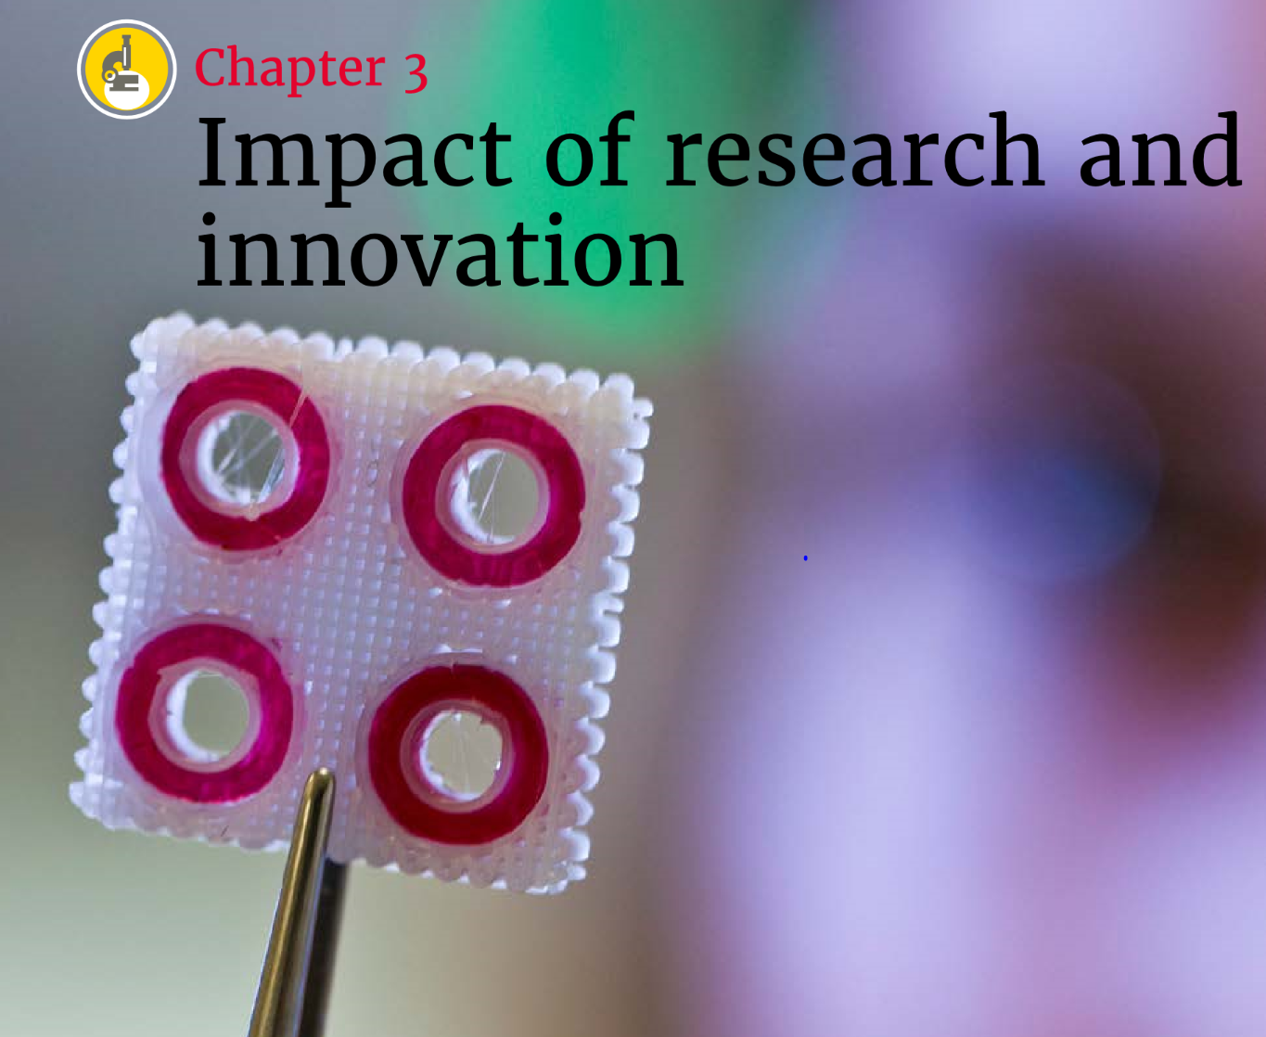
Notes:
The University published a new strategy in 2016

Slide 22
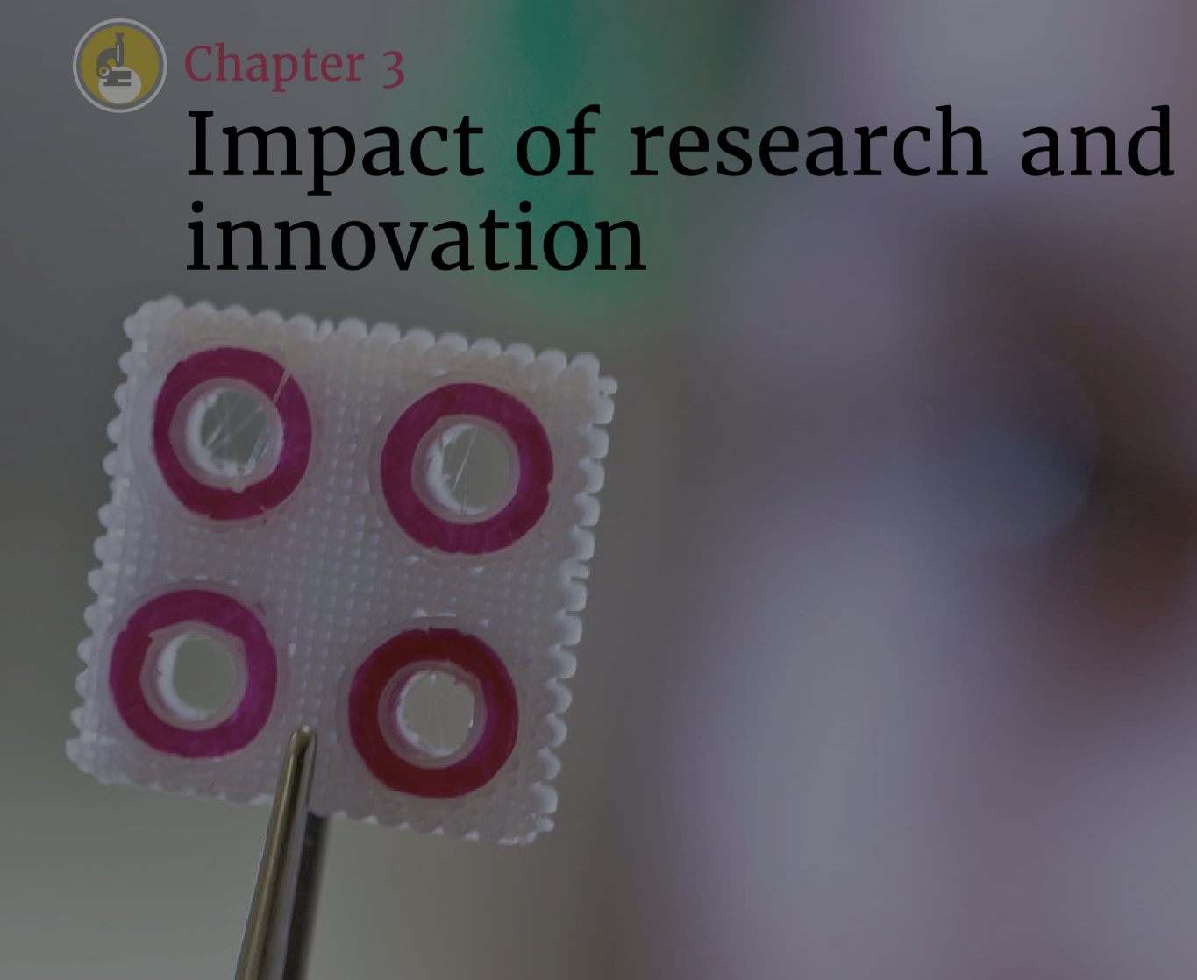
Utrecht University
aims to operate at the forefront
of Open Science
Notes:
With an ambition in Open Science

Slide 23
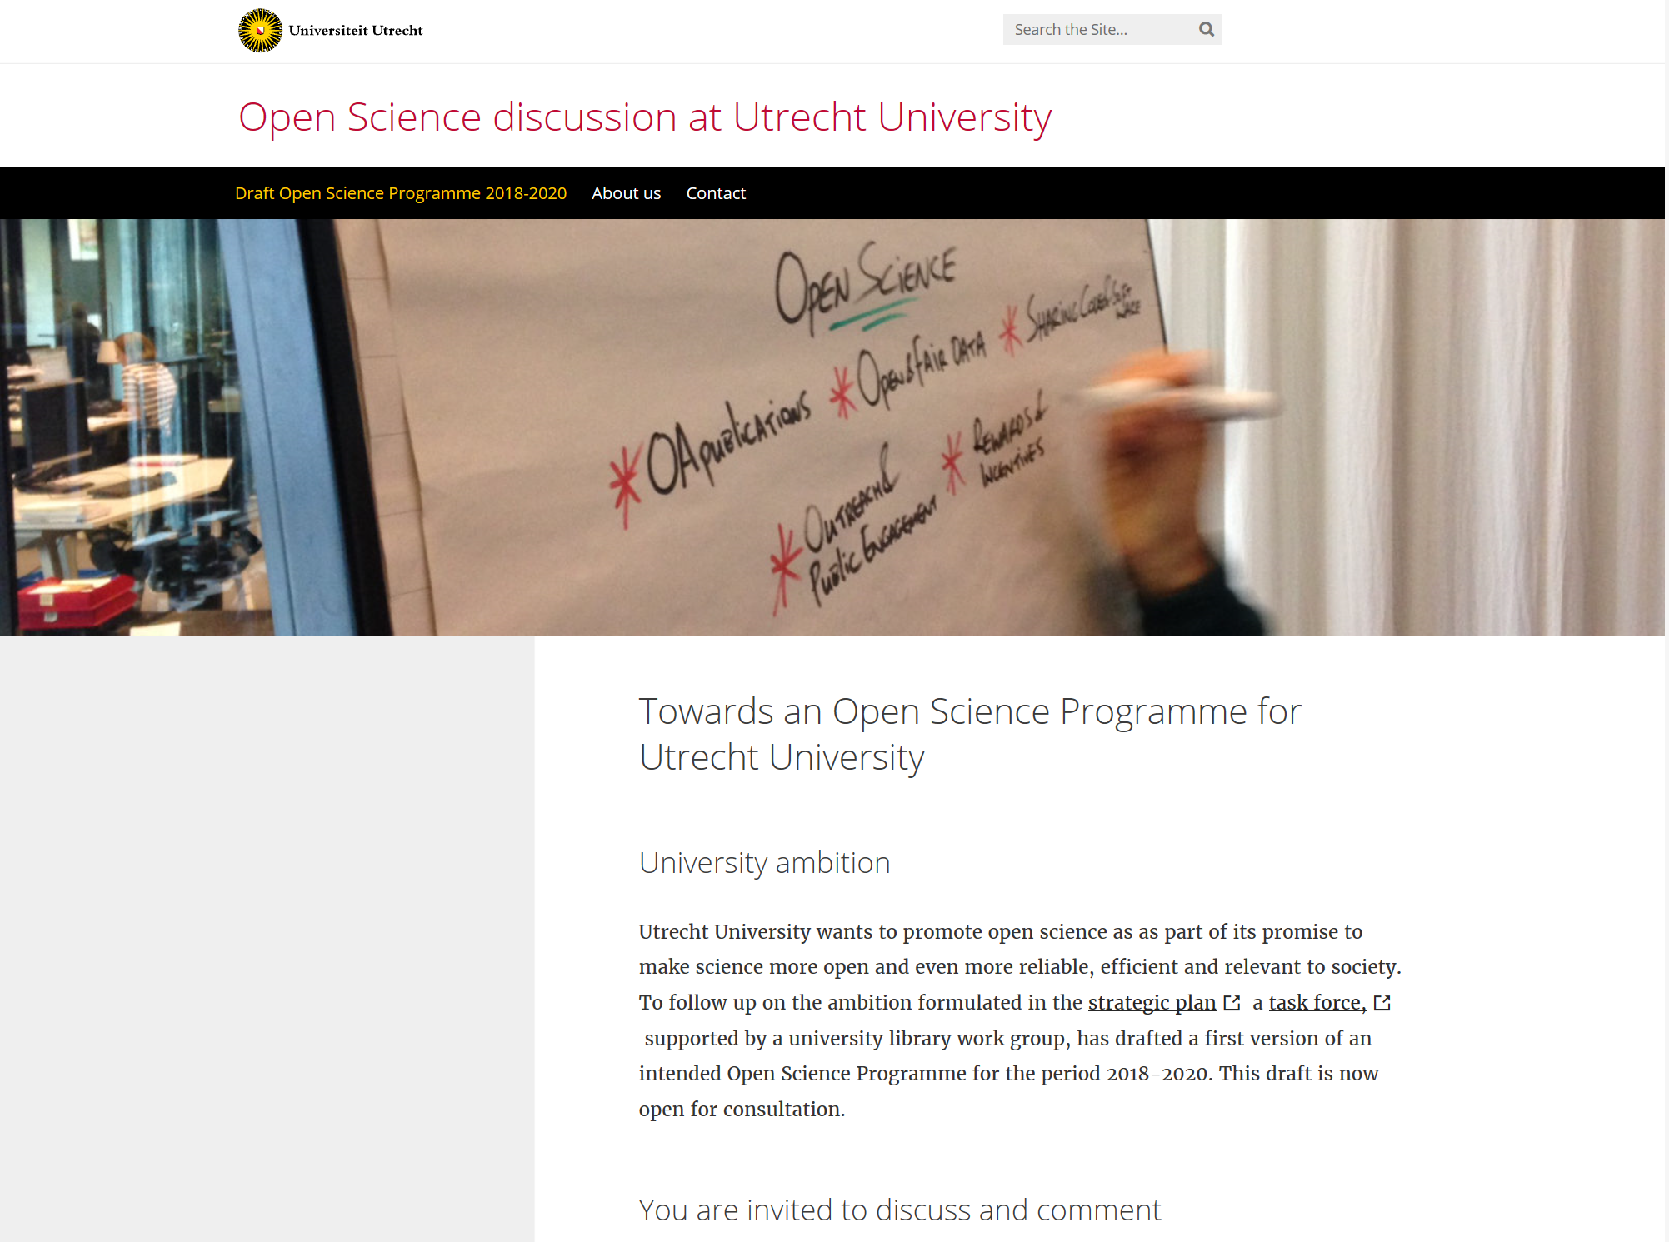
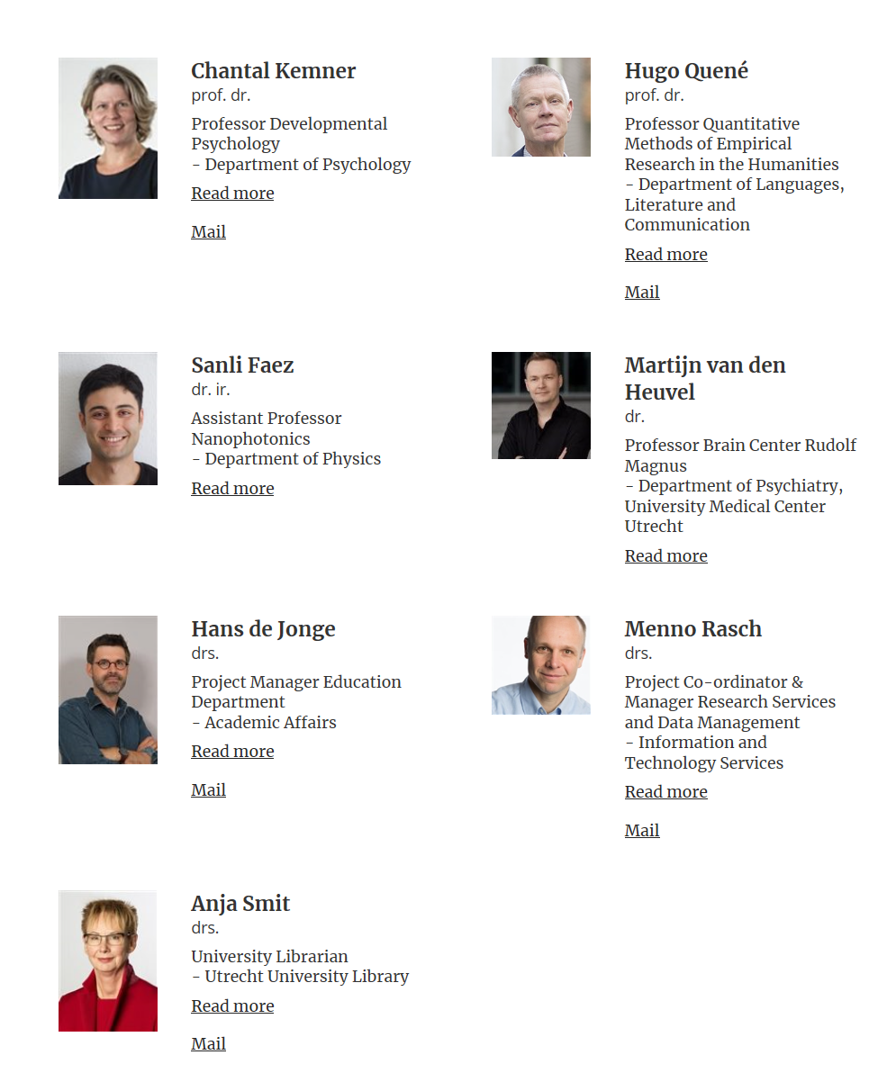
https://open-science.sites.uu.nl/
Notes:
The library in Utrecht University proposed to develop an Open Science Programme for the University. Carried out by the research community, organized by a multidiscipline team. A small task force has prepared a draft proposal, which is now open for consultation. If you are interested, the proposal is open access.

Slide 24
Merci pour votre attention!
Anja Smit
University Librarian

